Slide 1

“DESIGN AND IMPLEMENTATION OF 6T SRAM CELL”
MANGALORE INSTITUTE OF TECHNOLOGY & ENGINEERING
Accredited by NAAC with A+ Grade, An ISO 9001: 2015 Certified Institution
(A Unit of Rajalaxmi Education Trust®, Mangalore - 575001)
Affiliated to V.T.U., Belagavi, Approved by AICTE, New Delhi.
DEPARTMENT OF ELECTRONICS & COMMUNICATION ENGINEERING
(Accredited by NBA)
Project Associates:
ROSHAN CHANDRAHAS HEGDE 4MT20EC061
B RAHUL 4MT20EC021
GOURI RAVINDRA GUMATHANNAVAR 4MT20EC033
SUJAY 4MT20EC076
Guide: Ms. Sowjanya
Assistant Professor
Dept of ECE

Slide 2
Problem Statement
To design a low-power 6T SRAM that is suitable for use in energy-efficient electronic systems.
The challenge is to reduce the power consumption of the 6T SRAM while maintaining high performance and reliability, to achieve a balance between power consumption and operational stability, as well as to improve the energy efficiency of devices that use 6T SRAM, such as mobile devices, IoT applications, and wearable devices.

Slide 3
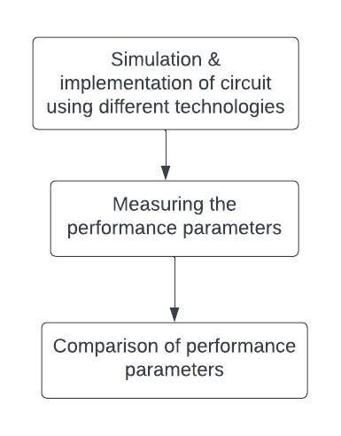
Methodology / Block Diagram/ Flowchart

Slide 4
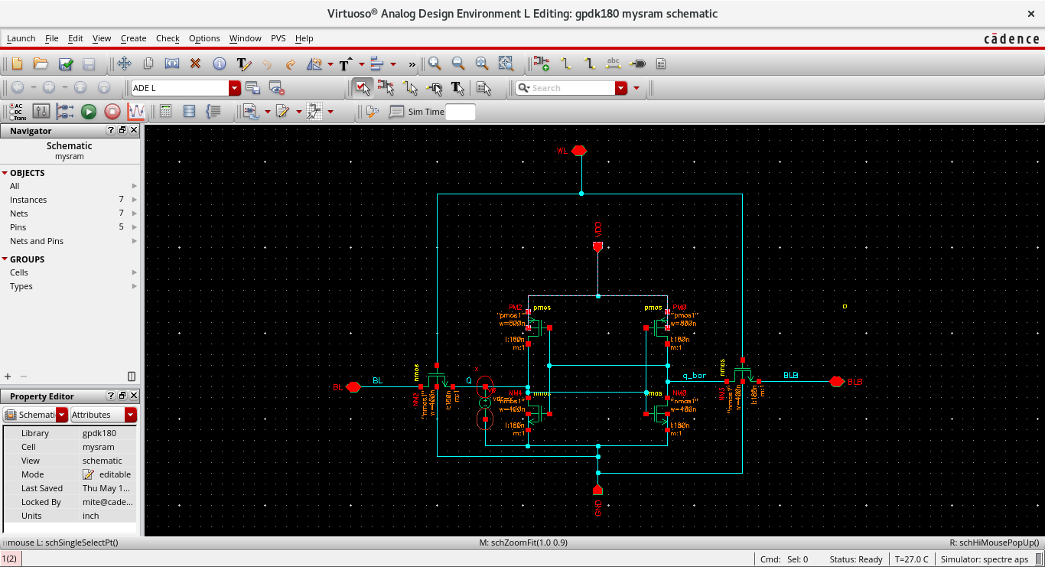
6T SRAM 180nm CIRCUIT

Slide 5
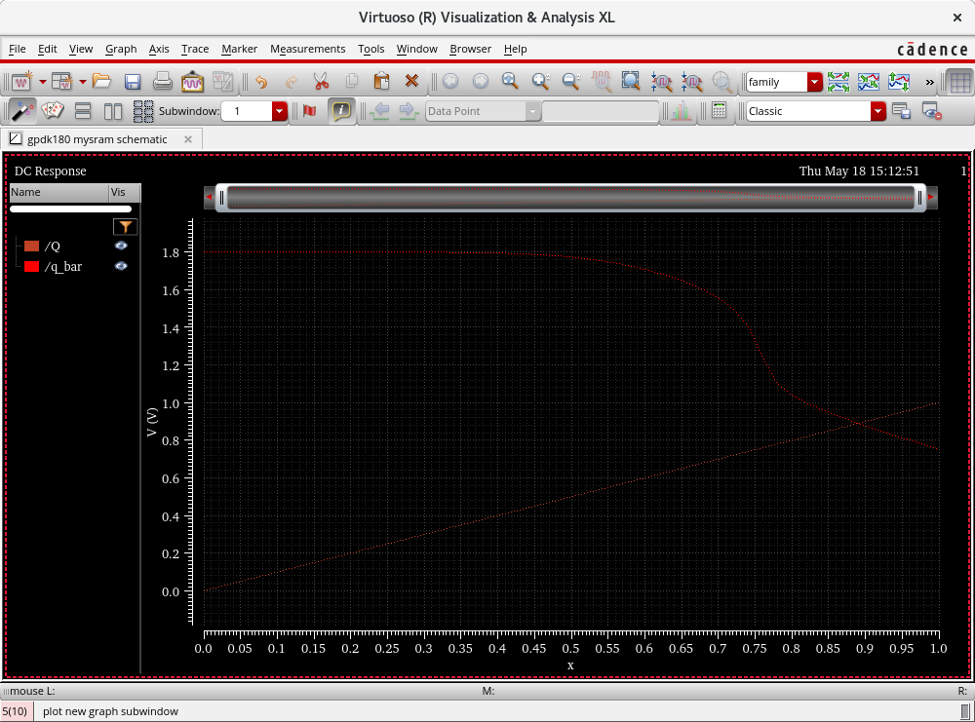
DC response

Slide 6
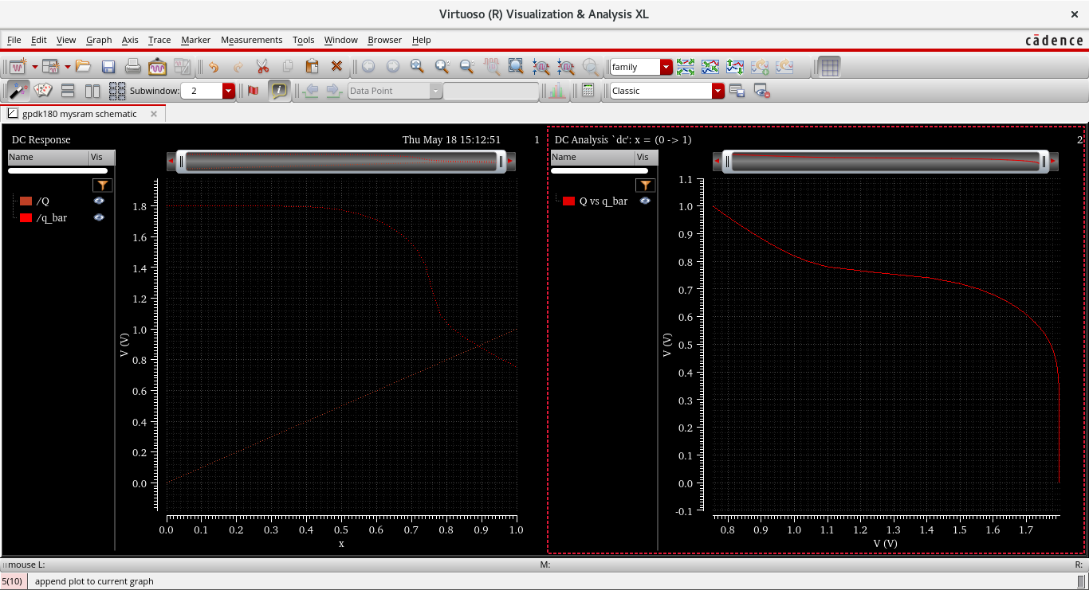
DC RESPONSE & DC ANALYSIS

Slide 7
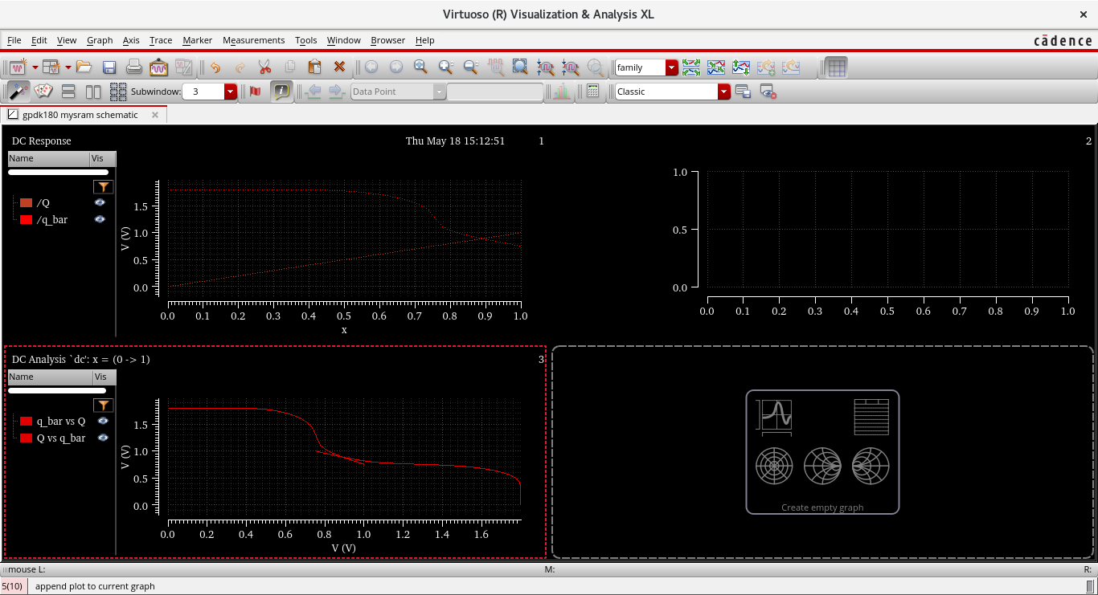
BUTTERFLY CURVE

Slide 8
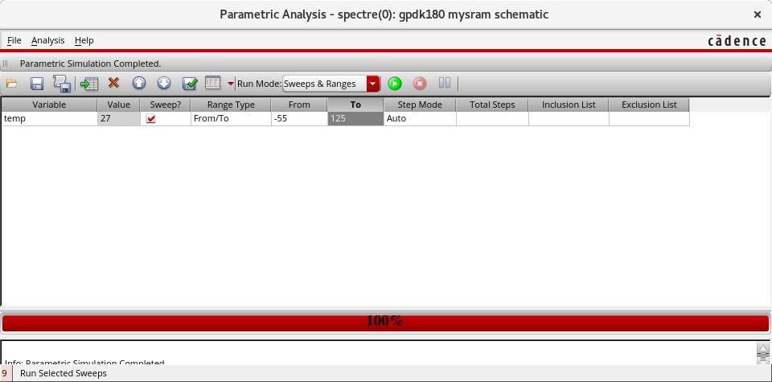
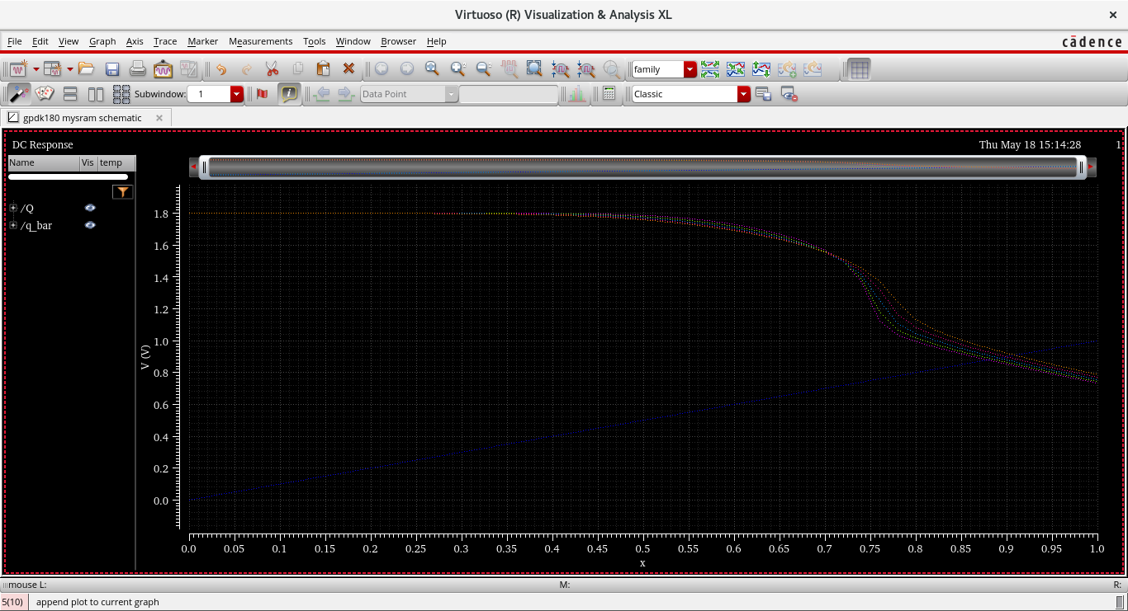
TEMPERATURE

Slide 9
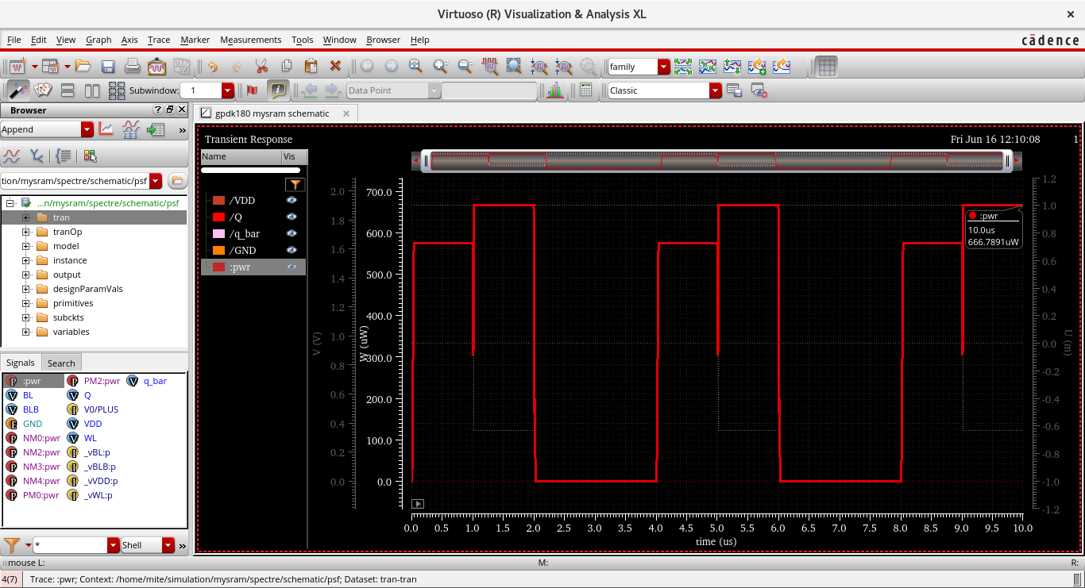
POWER

Slide 10
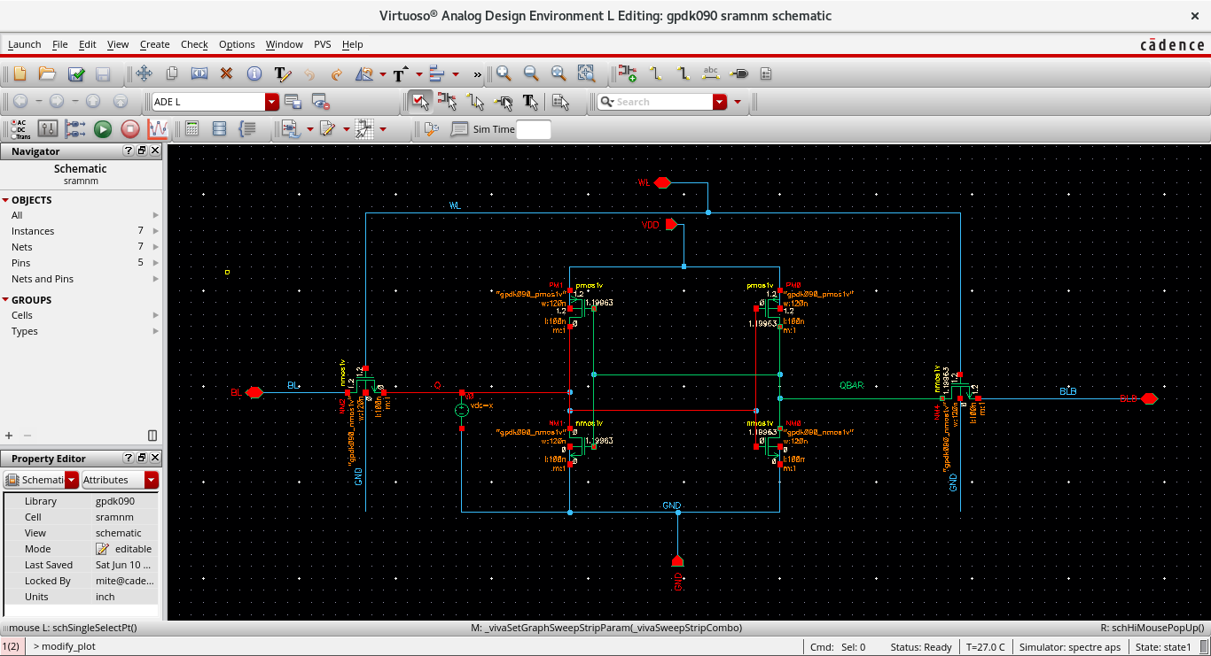
6T SRAM 90nm CIRCUIT

Slide 11
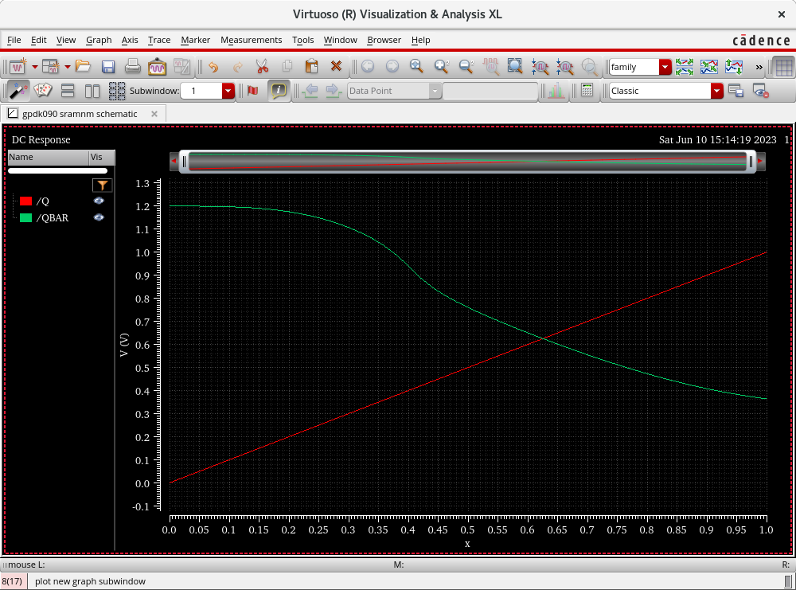
DC RESPONSE

Slide 12
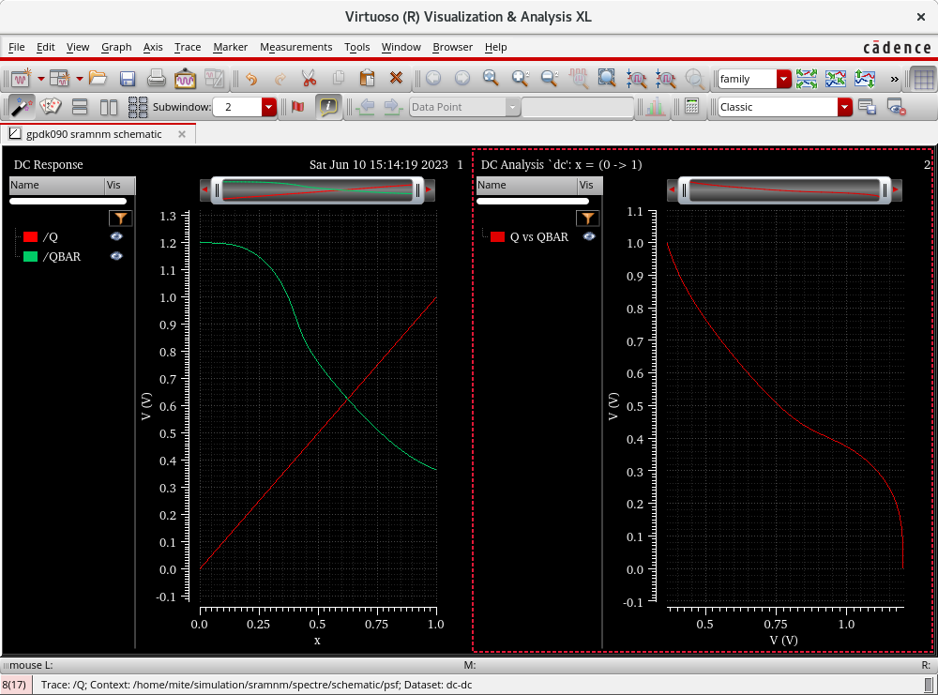
DC RESPONSE & DC ANALYSIS

Slide 13
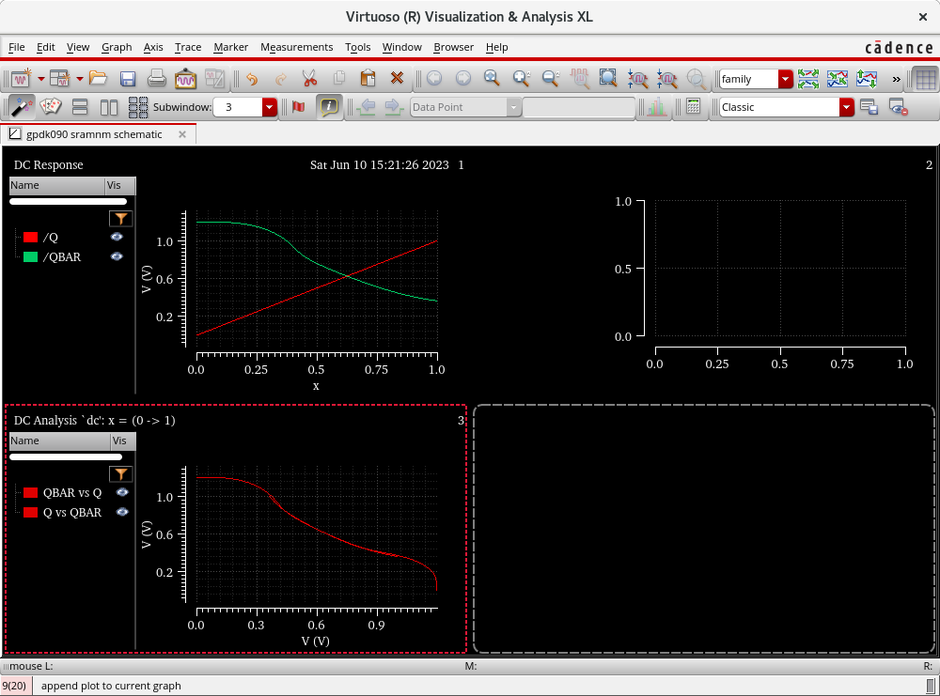
BUTTERFLY CURVE

Slide 14
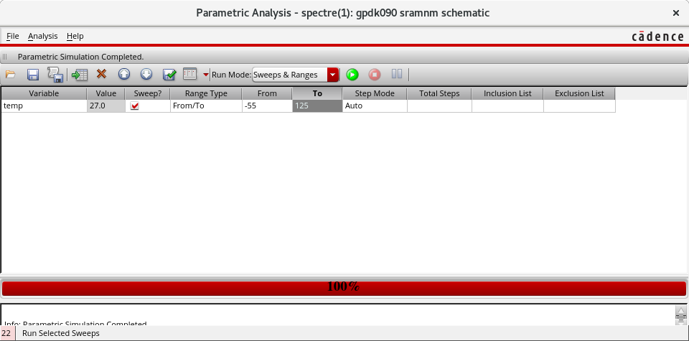
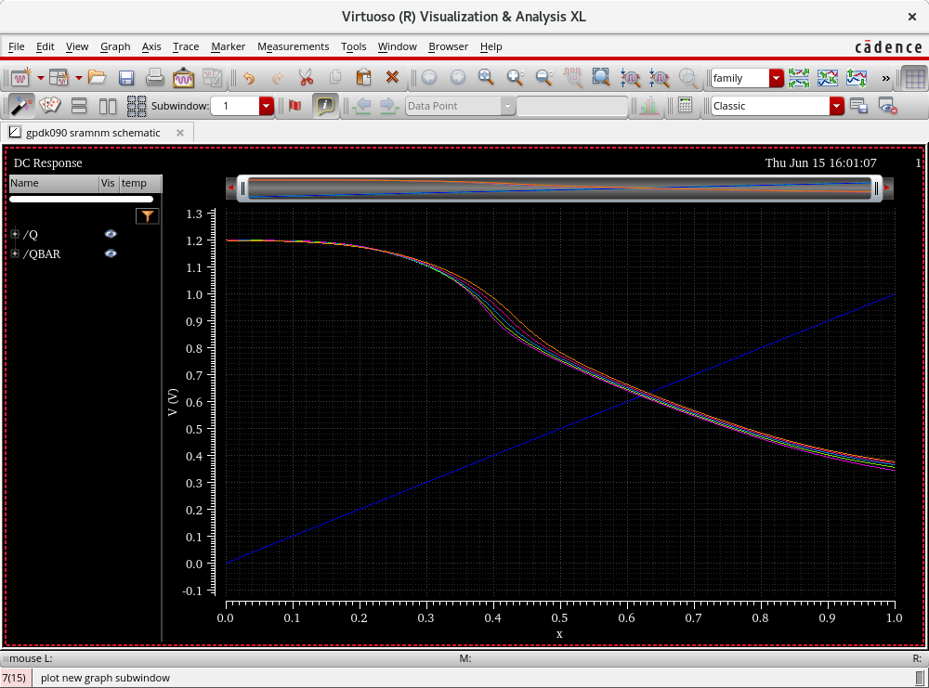
TEMPERATURE

Slide 15
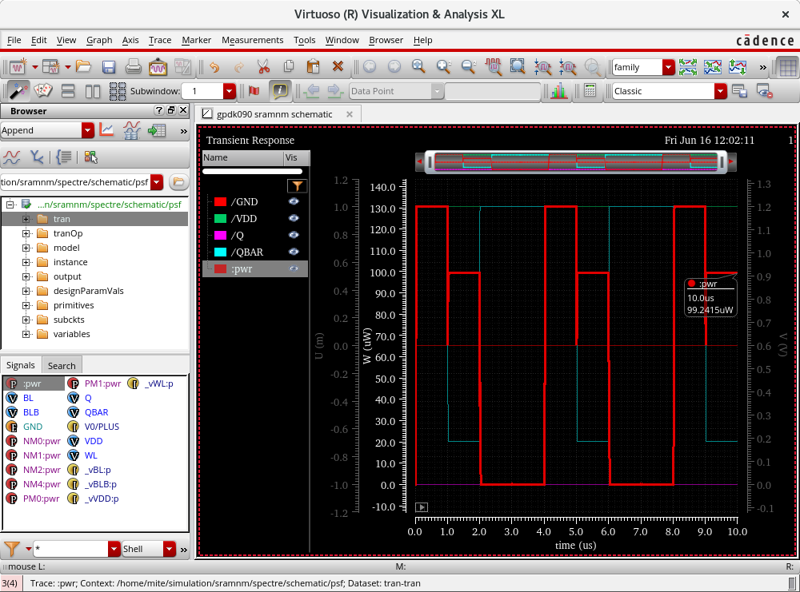
POWER

Slide 16
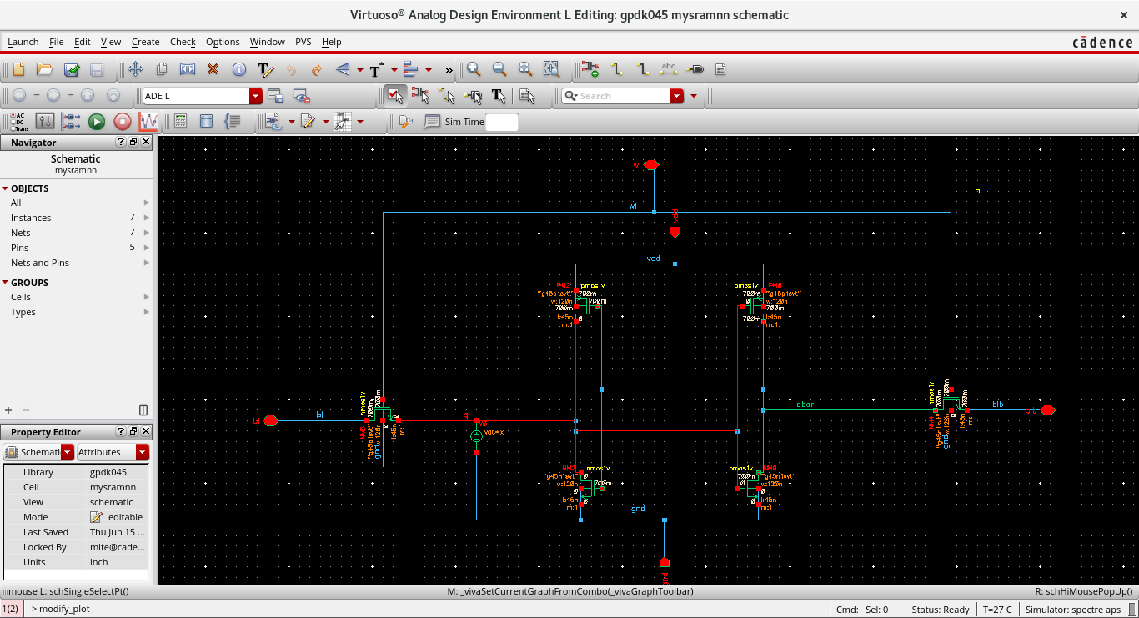
6T SRAM 45nm CIRCUIT

Slide 17
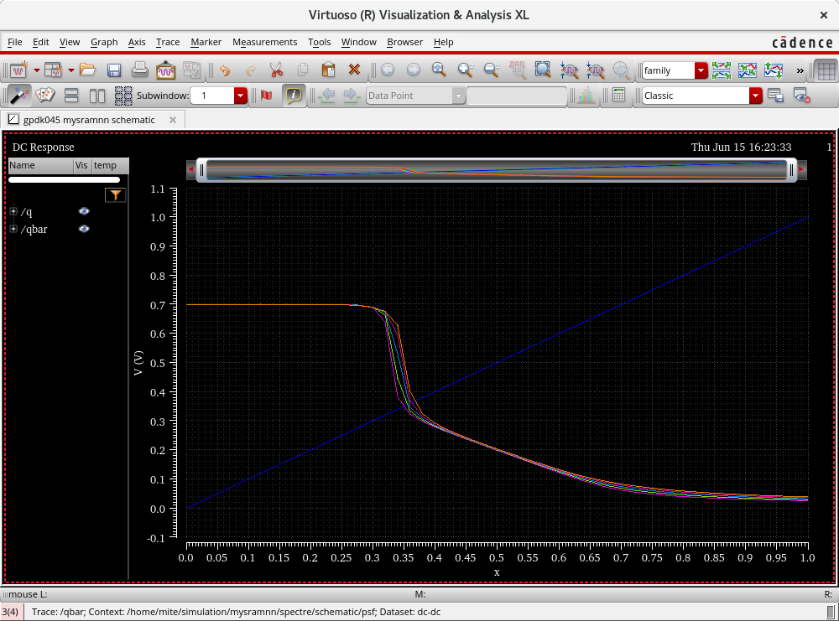
DC RESPONSE

Slide 18
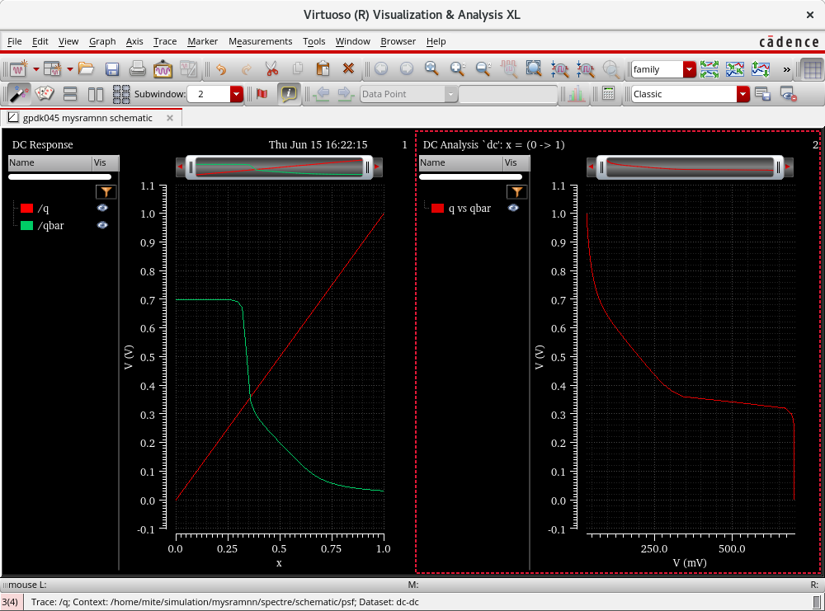
DC RESPONSE & DC ANALYSIS

Slide 19
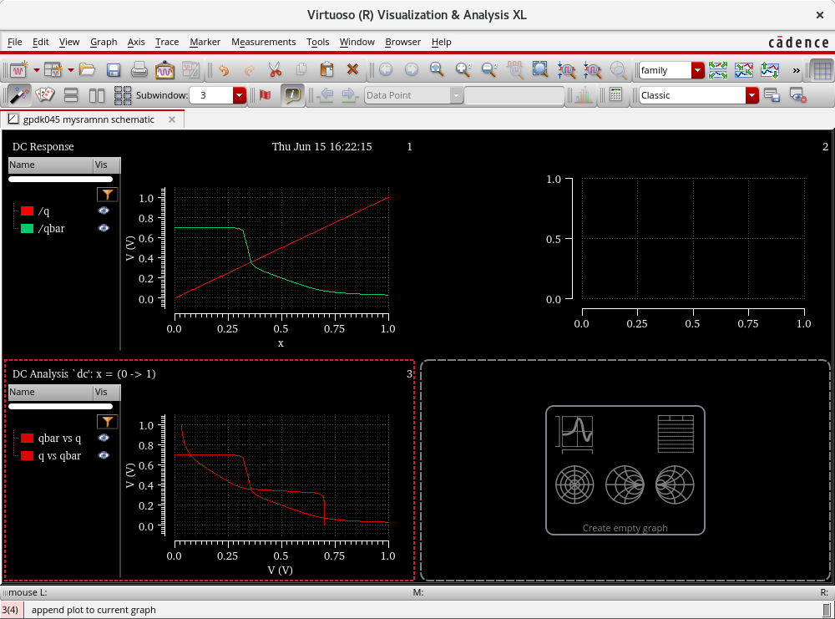
BUTTERFLY CURVE

Slide 20
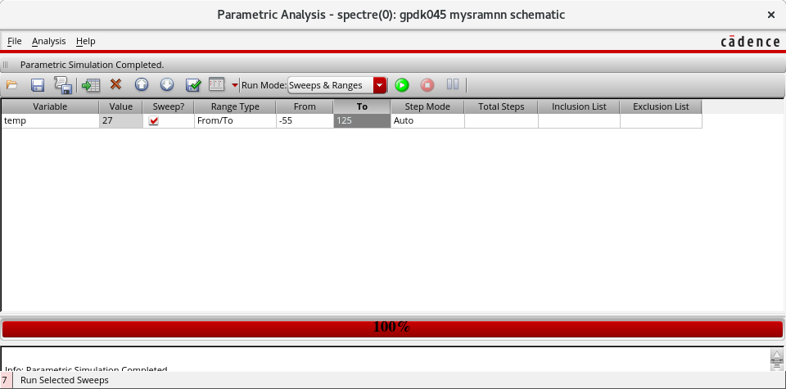
TEMPERATURE

Slide 21
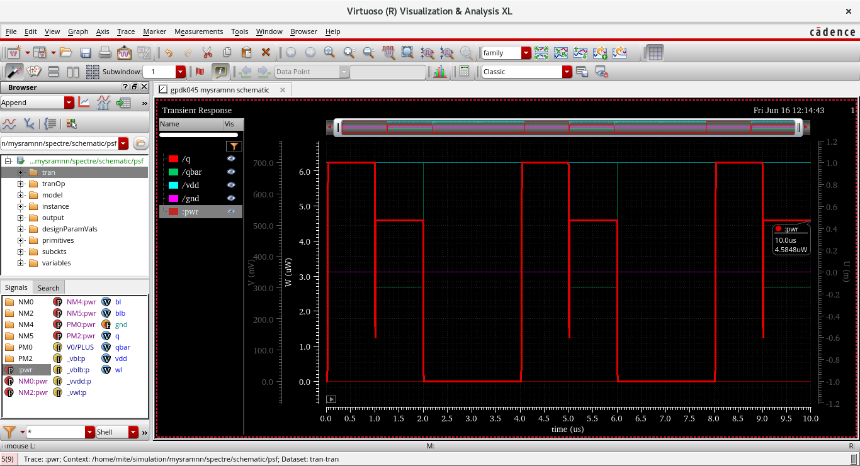
POWER

Slide 22
Work to be done
Task description
Start date
End Date
Status
Task description | Start date | End Date | Status
Reviewed IEEE paper related to present project, exposure to Cadence Tool and implementation of basic circuits. | 1/04/2023 | 30/04/2023 | Completed.
Design and implementation of 6T SRAM cell and measuring the performance parameters. | 1/05/2023 | 31/05/2023 | Completed..
Comparison of performance parameters & review paper. | 1/06/2023 | 30/06/2023 | Completed.

Slide 23
References
Shin C, Cho MH, Tsukmoto Y, Nguyen BY, Mazure C, Nikolic B, Liu TTK., “Performance and area scaling benefits of FD-SOI technology for 6-T SRAM Cells at the 22-nm Node”, IEEE Transactions on electron devices. 2010 Jun; 57(6). 13. Chandrak
Keerthi R, Chen H. “Stability and SNM analysis of low power SRAM”, IEEE International Instrumentation and Measurement Technology Conference, Victoria Canada; 2008 May. p.1541–4.
Christiensen D.C. Arandilla, Anastacia B. Alvarez, and Christian Raymund K. Roque ,“Static Noise Margin of 6T SRAM Cell in 90-nm CMOS”, IEEE UKSim 13th International Conference on Modelling and Simulation, pp534-539, 2011.
Prajna Mishra, Eugene John and Wei-Ming Lin, “Static Noise Margin and Power Dissipation Analysis of various SRAM Topologies”, IEEE 56th International Midest Symposium on Circuits and System.

Slide 24
5. Calhoun, B.H., and Chandrakasan, A.: “Analysing static noise margin for sub-threshold SRAM in 65nm CMOS”, Solid-State Circuits Conference, Proceedings of the 31st European, 2005, pp. 363-366ms (MWSCAS), pp469472, 2013.
6. Arora G, Poonam, Singh A, “SNM Analysis of SRAM Cells at 45nm, 32nm and 22nm technology”, International Journal of Engineering Research and General Science. 2014 Jun–Jul; 2(4):785–9.
7. Hiroyuki Yamauchi, “A Discussion on SRAM Circuit Design Trend in Deeper Nanometre-Scale Technologies”, in IEEE TRANSACTIONS ON VERY LARGE-SCALE INTEGRATION (VLSI) SYSTEMS, VOL. 18, NO. 5, MAY 2010.
8. Abhishek Agal et al, “6T SRAM Cell: Design and Analysis in Int. Journal of Engineering Research and Applications”, www.ijera.com ISSN: 2248-9622, Vol. 4, Issue 3(Version1), March 2014, pp.574-57.
9. Arvind Kumar Nigam et. Al, “6T SRAM Cell: Design and Analysis”, in Intl JEngg Sci Adv Research 2015 June ;1(2):27-29.
10. K. Dhananjay, Dr. M. N. Giri Prasad, Dr.K.Padmaraju and Dr. M. Raja Reddy, “Design of Low Power SRAM in 45 ηm CMOS Technology” ,in International Journal of Engineering Research and Applications (IJERA) ISSN: 2248-9622.

